Slide 1
BETWEENNESS CENTRALITY

Slide 2
Definition
In graph theory, betweenness centrality is a measure of centrality in a graph based on shortest paths.
Means, Betweenness centrality measures how frequently a node appears on the shortest path between other nodes in the graph.
Although earlier authors have intuitively described centrality as based on betweenness, Freeman (1977) gave the first formal definition of betweenness centrality.

Slide 3
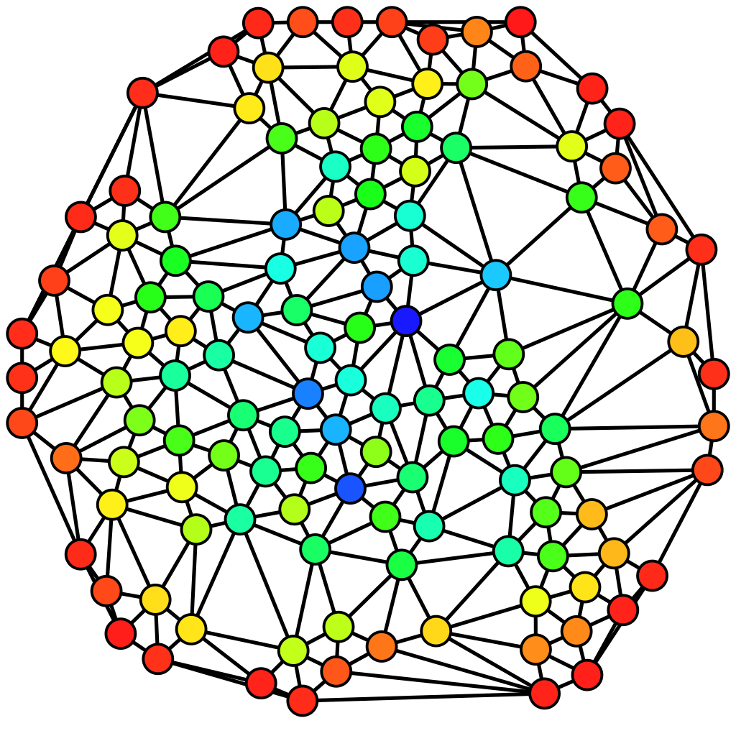
Towards more red color tells less probability
Towards more blue color tells high probability
An undirected graph colored based on the betweenness centrality of each vertex from least (red) to greatest (blue). Source: Wikipedia

Slide 4
Terminology going ahead…
Graph G = (V, E); where V ∈ {set of vertices in G} and E ∈ {set of edges in G}
n and m to denote the number of vertices and edges, respectively.
ω be a weight function on the edges, where ω(e) > 0, e ∈ E, for weighted graphs, and define ω(e) = 1, e ∈ E, for unweighted graphs
dG(s, t) to denote the distance between vertices s and t; where s,t ∈ V, i.e. the minimum length of any path connecting s and t in G
By definition, dG(s, s) = 0 for every s ∈ V , and dG(s, t) = dG(t, s) for s, t ∈ V
Let σst = σts denote the number of shortest paths from s ∈ V to t ∈ V , where σss = 1 by convention.
Let σst(v) denote the number of shortest paths from s to t that some v ∈ V lies on.

Slide 5
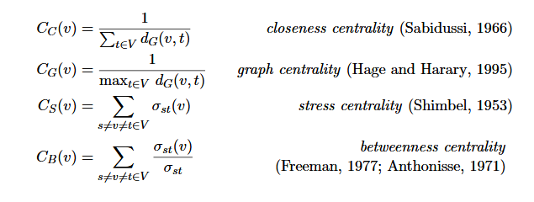
Some of standard measure of centrality

Slide 6
Complexity for naïve approach
So, both Dijkstra’s(weighted if implemented using adjacency list and Fibonacci heap) and BFS(unweighted) algo are used to compute the length and #all shortest paths from s ∈ V to other vertices easily with O(m) and O(m + n log n) time complexity respectively.
Consequently, σst, s, t ∈ V , can be computed in time O(nm) for unweighted and in time O(nm + n² log n) for weighted graphs
Running time is dominated by the Θ(n³) time (for each vertex, we need to sum n² pairs) to sum pair-dependencies.
Note:-
Θ(n³) complexity can be reduced by Brandes algorithm(we’ll see in next slides).

Slide 7


BC by Ulrik Brandes
Lemma 1 (Bellman criterion): A vertex v ∈ V lies on a shortest path between vertices s, t ∈ V , if and only if dG(s, t) = dG(s, v) + dG(v, t).
Given pairwise distances and shortest paths counts, the pair-dependency δst(v) of a pair s, t ∈ V on an intermediary v ∈ V is
And #shortest paths between s and t that v lies on, is given by
---eq(1)
So by using pair-dependency we can redefine the betweenness-centrality formula as

Slide 8

BC by Ulrik Brandes
We count shortest paths using traversal algorithms breadth-first search (BFS) for unweighted and Dijkstra’s algorithm for weighted graphs start with a specified source s ∈ V.
Lemma 2(Predecessors counting)
Define the set of predecessors of a vertex v on shortest paths from s as
---eq(2)
Lemma 3 (Combinatorial shortest-path counting): For s != v ∈ V
---eq(3)
Proof: Since all edge weights are positive, the last edge of any shortest path from s to v is an edge {u, v} ∈ E such that d_{G}(s, u) < d_{G}(s, v). Clearly, the number of shortest paths from s to v ending with this edge equals the number of shortest paths from s to u.

Slide 9
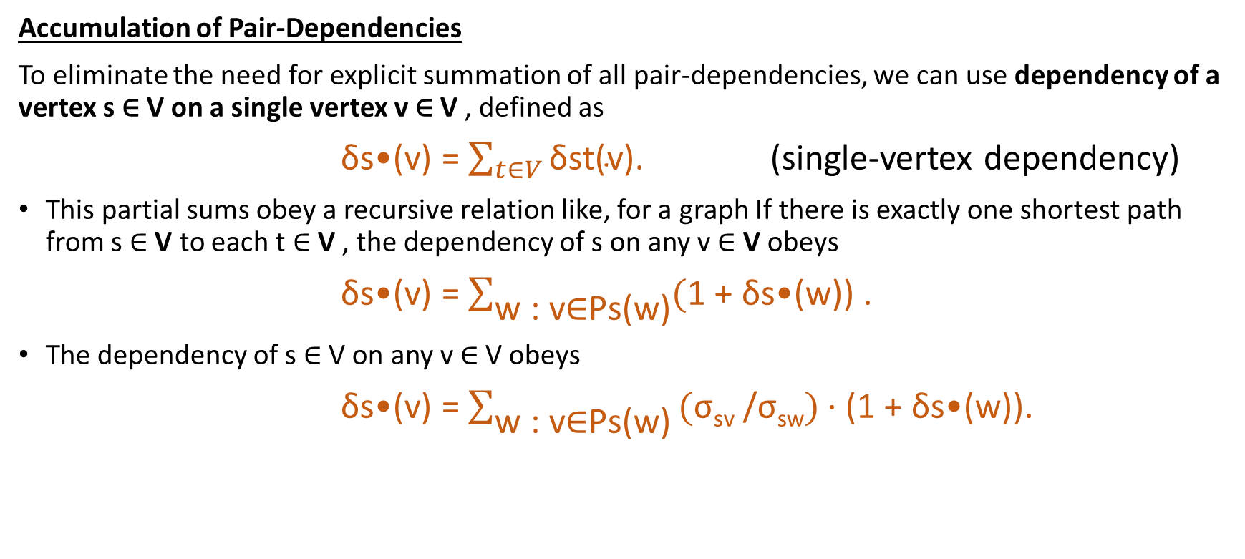
BC by Ulrik Brandes
Accumulation of Pair-Dependencies
To eliminate the need for explicit summation of all pair-dependencies, we can use dependency of a vertex s ∈ V on a single vertex v ∈ V , defined as
δs•(v) = $\sum_{t∈V}{\text{δ}\text{st}\text{(}\text{v}\text{).}}$ (single-vertex dependency)
This partial sums obey a recursive relation like, for a graph If there is exactly one shortest path from s ∈ V to each t ∈ V , the dependency of s on any v ∈ V obeys
δs•(v) = $\sum_{\text{w}\text{ : }\text{v}\text{∈}\text{Ps}\text{(}\text{w}\text{)}}{(\text{1 + }\text{δs}\text{•(}\text{w}\text{)) .}}$
The dependency of s ∈ V on any v ∈ V obeys
δs•(v) = $\sum_{\text{w}\text{ : }\text{v}\text{∈}\text{Ps}\text{(}\text{w}\text{)}}{\text{(}\text{σ}\text{sv} \text{/}\text{σ}\text{sw}\text{) }\text{· (1 + }\text{δs}\text{•(}\text{w}\text{))}}$.

Slide 10

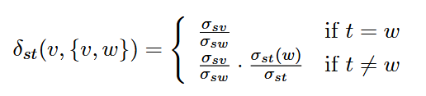
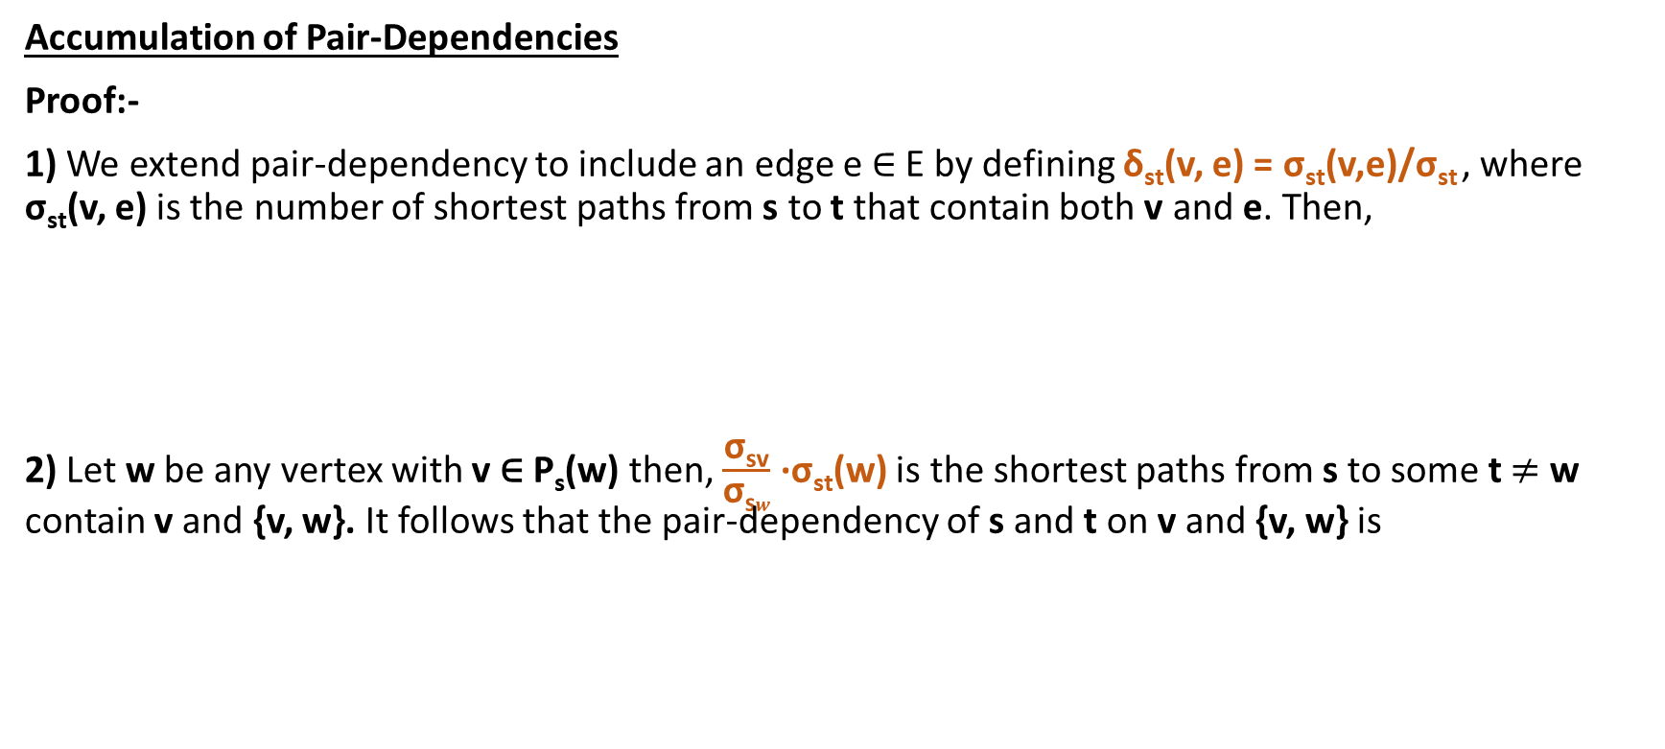
BC by Ulrik Brandes
Accumulation of Pair-Dependencies
Proof:-
1) We extend pair-dependency to include an edge e ∈ E by defining δ_{st}(v, e) = σ_{st}(v,e)/σ_{st} , where σ_{st}(v, e) is the number of shortest paths from s to t that contain both v and e. Then,
2) Let w be any vertex with v ∈ P_{s}(w) then, $\frac{\text{σ}\text{sv}}{\text{σ}\text{s}w}$ ·σ_{st}(w) is the shortest paths from s to some t $≠$ w contain v and {v, w}. It follows that the pair-dependency of s and t on v and {v, w} is

Slide 11
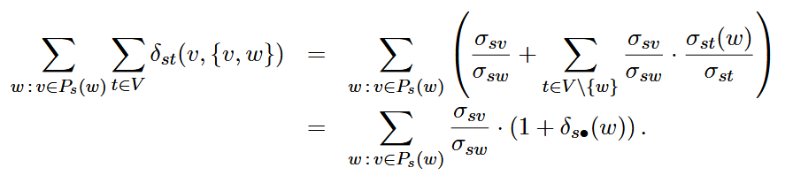
BC by Ulrik Brandes
Accumulation of Pair-Dependencies
Proof:-
3) Inserting this into the above yields

Slide 12
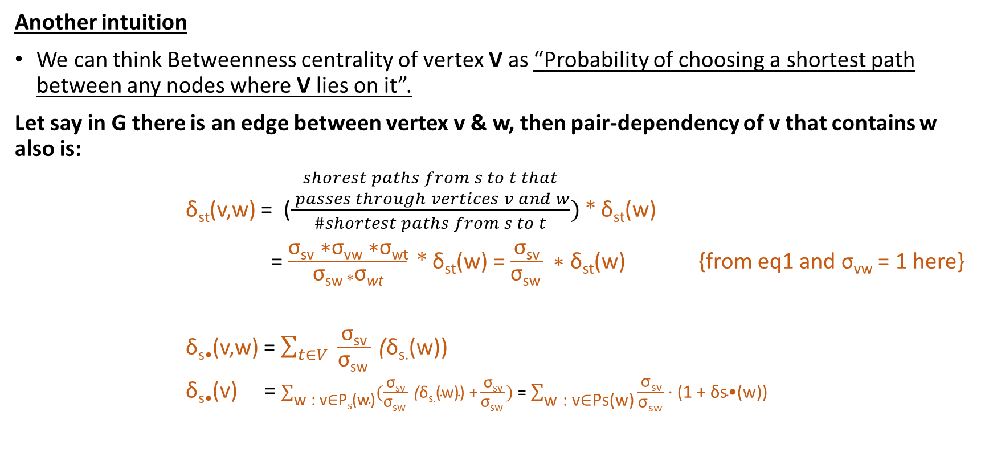
BC by Ulrik Brandes
Another intuition
We can think Betweenness centrality of vertex V as “Probability of choosing a shortest path between any nodes where V lies on it”.
Let say in G there is an edge between vertex v & w, then pair-dependency of v that contains w also is:
δ_{st}(v,w) = ($\frac{\begin{aligned}\#\#\#\#\#\#\#\#shorest paths from s to t that \\ passes through vertices v and &w\end{aligned}}{\#shortest paths from s to t}) \text{*} \text{δ}\text{st}\text{(}\text{w}\text{)}$
= $\frac{\text{σ}\text{sv}\text{ ∗}\text{σ}\text{vw}\text{ ∗}\text{σ}\text{wt}}{\text{σ}\text{sw}\text{ *}\text{σ}\text{wt}}\text{ * }\text{δ}\text{st}\text{(}\text{w}\text{)}$ = $\frac{\text{σ}\text{sv}}{\text{σ}\text{sw} }\text{ ∗ }\text{δ}\text{st}\text{(}\text{w}\text{)}$ {from eq1 and $\text{σ}\text{vw} \text{= 1 }\text{here}$}
δ_{s•}(v,w) = $\sum_{t∈V}{ \frac{\text{σ}\text{sv}}{\text{σ}\text{sw} } \text{(}\text{δ}\text{s}\text{.}\text{(}\text{w}\text{))}}$
δ_{s•}(v) = $\sum_{\text{w}\text{ : }\text{v}\text{∈}\text{Ps}\text{(}\text{w}\text{)}}{(\frac{\text{σ}\text{sv}}{\text{σ}\text{sw} } \text{(}\text{δ}\text{s}\text{.}\text{(}\text{w}\text{)) +}\frac{\text{σ}\text{sv}}{\text{σ}\text{sw} }})$ = $\sum_{\text{w}\text{ : }\text{v}\text{∈}\text{Ps}\text{(}\text{w}\text{)}}{\frac{\text{σ}\text{sv}}{\text{σ}\text{sw} }\text{· (1 + }\text{δs}\text{•(}\text{w}\text{))}}$

Slide 13
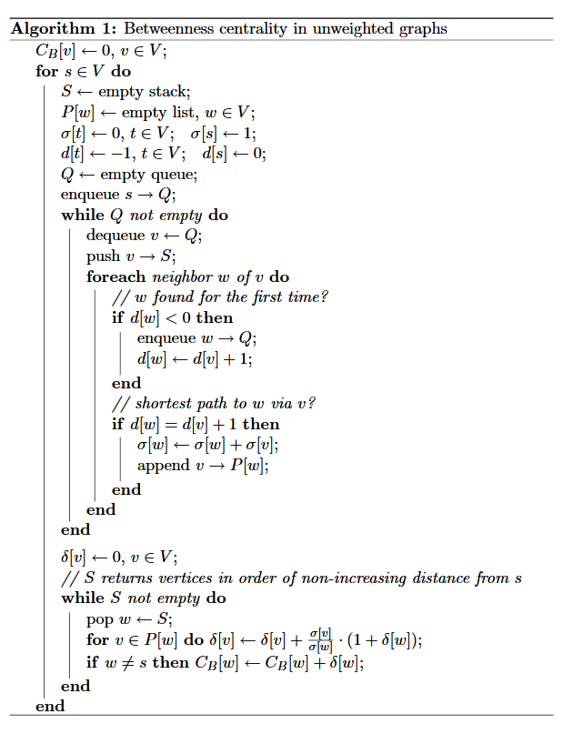
BC by Ulrik Brandes

Slide 14
Algo demonstration (Iteration: 1, Source: s, σ[s] = 1, d[s]=0)
STACK path:
QUEUE Q:
CURR:
CB[t]: 0
P:
σ:
d: -1
t
CB[s]: 0
P:
σ: 1
d: 0
CB [u] : 0
P:
σ:
d: -1
CB [w] : 0
P:
σ:
d: -1
CB [x] : 0
P:
σ:
d: -1
s
u
w
x
CB [v] : 0
P:
σ:
d: -1
v

Slide 15
Algo demonstration (Iteration: 1, Source: s, σ[s] = 1, d[s]=0)
STACK path:
QUEUE Q: s-
CURR:
CB[t]: 0
P:
σ:
d: -1
1) Start BFS from vertex S as source
2) Push S into Queue
t
CB[s]: 0
P:
σ: 1
d: 0
CB [u] : 0
P:
σ:
d: -1
CB [w] : 0
P:
σ:
d: -1
CB [x] : 0
P:
σ:
d: -1
s
u
w
x
CB [v] : 0
P:
σ:
d: -1
v

Slide 16
Algo demonstration (Iteration: 1, Source: s, σ[s] = 1, d[s]=0)
STACK path: s
QUEUE Q:
CURR: s (dequeue Q)
CB[t]: 0
P:
σ:
d: -1
1) Dequeue Q
2) Push s to stack path
t
CB[s]: 0
P:
σ: 1
d: 0
CB [u] : 0
P:
σ:
d: -1
CB [w] : 0
P:
σ:
d: -1
CB [x] : 0
P:
σ:
d: -1
s
u
w
x
CB [v] : 0
P:
σ:
d: -1
v

Slide 17
Algo demonstration (Iteration: 1, Source: s, σ[s] = 1, d[s]=0)
STACK path: s
QUEUE Q: t
CURR: s
CB[t]: 0
P: {s}
σ: 1
d: d[s] + 1 = 1
1) Push t to Q.
2) Update shortest distance from source s to node t.
3) If d[t] = d[CURR] + 1, update σ[t] and push CURR to P[t]
t
CB[s]: 0
P:
σ: 1
d: 0
CB [u] : 0
P:
σ: 1
d: -1
CB [w] : 0
P:
σ:
d: -1
CB [x] : 0
P:
σ:
d: -1
s
u
w
x
CB [v] : 0
P:
σ:
d: -1
v

Slide 18
Algo demonstration (Iteration: 1, Source: s, σ[s] = 1, d[s]=0)
STACK path: s
QUEUE Q: t-u
CURR: s
CB[t]: 0
P: {s}
σ: 1
d: 1
1) Push u to Q
2) Update shortest distance from source s to node u
3) If d[u] = d[CURR] + 1, update σ[u] and push CURR to P[u]
t
CB[s]: 0
P:
σ: 1
d: 0
CB [u] : 0
P: {s}
σ:
d: d[s] + 1 = 1
CB [w] : 0
P:
σ:
d: -1
CB [x] : 0
P:
σ:
d: -1
s
u
w
x
CB [v] : 0
P:
σ:
d: -1
v

Slide 19
Algo demonstration (Iteration: 1, Source: s, σ[s] = 1, d[s]=0)
STACK path: s
QUEUE Q: t-u-v
CURR: s
CB[t]: 0
P: {s}
σ: 1
d: 1
1) Push v to Q
2) Update shortest distance from source s to node v
3) If d[v] = d[CURR] + 1, update σ[v] and push CURR to P[v]
t
CB[s]: 0
P:
σ: 1
d: 0
CB [u] : 0
P: {s}
σ: 1
d: 1
CB [w] : 0
P:
σ:
d: -1
CB [x] : 0
P:
σ:
d: -1
s
u
w
x
CB [v] : 0
P: {s}
σ: 1
d: d[s] + 1 = 1
v

Slide 20
Algo demonstration (Iteration: 1, Source: s, σ[s] = 1, d[s]=0)
STACK path: t|s
QUEUE Q: u-v
CURR: t
CB[t]: 0
P: {s}
σ: 1
d: 1
1) Dequeue Q
2) Push t to stack path
t
CB[s]: 0
P:
σ: 1
d: 0
CB [u] : 0
P: {s}
σ: 1
d: 1
CB [w] : 0
P:
σ:
d: -1
CB [x] : 0
P:
σ:
d: -1
s
u
w
x
CB [v] : 0
P: {s}
σ: 1
d: 1
v

Slide 21
Algo demonstration (Iteration: 1, Source: s, σ[s] = 1, d[s]=0)
STACK path: t|s
QUEUE Q: u-v-w
CURR: t
CB[t]: 0
P: {s}
σ: 1
d: 1
1) Push w to Q
2) Update shortest distance from source s to node w
3) If d[w] = d[CURR] + 1, update σ[w] and push CURR to P[w]
t
CB[s]: 0
P:
σ: 1
d: 0
CB [u] : 0
P: {s}
σ: 1
d: 1
CB [w] : 0
P: {t}
σ: 1
d: d[t] + 1 = 2
CB [x] : 0
P:
σ:
d: -1
s
u
w
x
CB [v] : 0
P: {s}
σ: 1
d: 1
v

Slide 22
Algo demonstration (Iteration: 1, Source: s, σ[s] = 1, d[s]=0)
STACK path: u|t|s
QUEUE Q: v-w
CURR: u
CB[t]: 0
P: {s}
σ: 1
d: 1
1) Dequeue Q
2) Push u to stack path
t
CB[s]: 0
P:
σ: 1
d: 0
CB [u] : 0
P: {s}
σ: 1
d: 1
CB [w] : 0
P: {t}
σ: 1
d: 2
CB [x] : 0
P:
σ:
d: -1
s
u
w
x
CB [v] : 0
P: {s}
σ: 1
d: 1
v

Slide 23
Algo demonstration (Iteration: 1, Source: s, σ[s] = 1, d[s]=0)
STACK path: u|t|s
QUEUE Q: v-w
CURR: u
CB[t]: 0
P: {s}
σ: 1
d: 1
1) If d[w] = d[CURR] + 1, update σ[w] and push CURR to P[w]
t
CB[s]: 0
P:
σ: 1
d: 0
CB [u] : 0
P: {s}
σ: 1
d: 1
CB [w] : 0
P: {t, u}
σ: 2
d: 2
CB [x] : 0
P:
σ:
d: -1
s
u
w
x
CB [v] : 0
P: {s}
σ: 1
d: 1
v

Slide 24
Algo demonstration (Iteration: 1, Source: s, σ[s] = 1, d[s]=0)
STACK path: v|u|t|s
QUEUE Q: w
CURR: v
CB[t]: 0
P: {s}
σ: 1
d: 1
1) Dequeue Q
2) Push v to stack path
t
CB[s]: 0
P:
σ: 1
d: 0
CB [u] : 0
P: {s}
σ: 1
d: 1
CB [w] : 0
P: {t, u}
σ: 2
d: 2
CB [x] : 0
P:
σ:
d: -1
s
u
w
x
CB [v] : 0
P: {s}
σ: 1
d: 1
v

Slide 25
Algo demonstration (Iteration: 1, Source: s, σ[s] = 1, d[s]=0)
STACK path: v|u|t|s
QUEUE Q: w
CURR: v
CB[t]: 0
P: {s}
σ: 1
d: 1
1) If d[w] = d[CURR] + 1, update σ[w] and push CURR to P[w]
t
CB[s]: 0
P:
σ: 1
d: 0
CB [u] : 0
P: {s}
σ: 1
d: 1
CB [w] : 0
P: {t, u, v}
σ: 3
d: 2
CB [x] : 0
P:
σ:
d: -1
s
u
w
x
CB [v] : 0
P: {s}
σ: 1
d: 1
v

Slide 26
Algo demonstration (Iteration: 1, Source: s, σ[s] = 1, d[s]=0)
STACK path: w|v|u|t|s
QUEUE Q:
CURR: w
CB[t]: 0
P: {s}
σ: 1
d: 1
1) Dequeue Q
2) Push w to stack path
t
CB[s]: 0
P:
σ: 1
d: 0
CB [u] : 0
P: {s}
σ: 1
d: 1
CB [w] : 0
P: {t, u, v}
σ: 3
d: 2
CB [x] : 0
P:
σ:
d: -1
s
u
w
x
CB [v] : 0
P: {s}
σ: 1
d: 1
v

Slide 27
Algo demonstration (Iteration: 1, Source: s, σ[s] = 1, d[s]=0)
STACK path: w|v|u|t|s
QUEUE Q: x
CURR: w
CB[t]: 0
P: {s}
σ: 1
d: 1
1) Push x to Q
2) Update shortest distance from source s to node w
3) If d[x] = d[CURR] + 1, update σ[w] and push CURR to P[w]
t
CB[s]: 0
P:
σ: 1
d: 0
CB [u] : 0
P: {s}
σ: 1
d: 1
CB [w] : 0
P: {t, u, v}
σ: 3
d: 2
CB [x] : 0
P: {w}
σ: 3
d: d[w] + 1 = 3
s
u
w
x
CB [v] : 0
P: {s}
σ: 1
d: 1
v

Slide 28
Algo demonstration (Iteration: 1, Source: s, σ[s] = 1, d[s]=0)
STACK path: x|w|v|u|t|s
QUEUE Q:
CURR: x
CB[t]: 0
P: {s}
σ: 1
d: 1
1) Dequeue Q
2) Push x to stack path
t
CB[s]: 0
P:
σ: 1
d: 0
CB [u] : 0
P: {s}
σ: 1
d: 1
CB [w] : 0
P: {t, u, v}
σ: 3
d: 2
CB [x] : 0
P: {w}
σ: 3
d: 3
s
u
w
x
CB [v] : 0
P: {s}
σ: 1
d: 1
v

Slide 29
Algo demonstration (Iteration: 1, Source: s, σ[s] = 1, d[s]=0)
STACK path: x|w|v|u|t|s
QUEUE Q:
CURR:
CB[t]: 0
P: {s}
σ: 1
d: 1
δs.[t]:0
Declare & initialize δs. to 0 for all vertices
While STACK path is not empty, Calculate δs.[neighbor] for top of path and pop it.
t
CB[s]: 0
P:
σ: 1
d: 0
δs.[s]: 0
CB [u] : 0
P: {s}
σ: 1
d: 1
δs.[u]: 0
CB [w] : 0
P: {t, u, v}
σ: 3
d: 2
δs.[w]: 0
CB [x] : 0
P: {w}
σ: 3
d: 3
δs.[x]: 0
s
u
w
x
CB [v] : 0
P: {s}
σ: 1
d: 1
δs.[v]: 0
v

Slide 30
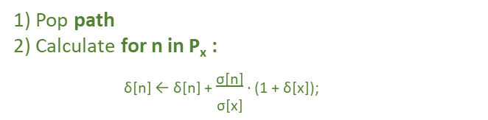

Algo demonstration (Iteration: 1, Source: s, σ[s] = 1, d[s]=0)
STACK path: w|v|u|t|s
QUEUE Q:
CURR pop: x
CURR n in P[x]: w
CB[t]: 0
P: {s}
σ: 1
d: 1
δs.[t]:0
1) Pop path
2) Calculate for n in P_{x} :
_{δ[n] ← δ[n] +} $\frac{\text{σ}\text{[}\text{n}\text{]}}{\text{σ}\text{[}\text{x}\text{]}}$ _{· (1 + δ[x]);}
t
CB[s]: 0
P:
σ: 1
d: 0
δs.[s]: 0
CB [u] : 0
P: {s}
σ: 1
d: 1
δs.[u]: 0
CB [w] : 0
P: {t, u, v}
σ: 3
d: 2
δs.[w] = 0+ $\frac{3}{3}.(1+0)$ = 1
CB [x] : 0
P: {w}
σ: 3
d: 3
δs.[x]: 0
s
u
w
x
CB [v] : 0
P: {s}
σ: 1
d: 1
δs.[v]: 0
v

Slide 31
Algo demonstration (Iteration: 1, Source: s, σ[s] = 1, d[s]=0)
STACK path: w|v|u|t|s
QUEUE Q:
CURR pop: x
CURR n in P[x]:
CB[t]: 0
P: {s}
σ: 1
d: 1
δs.[t]:0
1) Calculate CB [X] ← CB [X] + δ[x]
t
CB[s]: 0
P:
σ: 1
d: 0
δs.[s]: 0
CB [u] : 0
P: {s}
σ: 1
d: 1
δs.[u]: 0
CB [w] : 0
P: {t, u, v}
σ: 3
d: 2
δs.[w] = 1
CB [x] : 0
P: {w}
σ: 3
d: 3
δs.[x]: 0
s
u
w
x
CB [v] : 0
P: {s}
σ: 1
d: 1
δs.[v]: 0
v

Slide 32
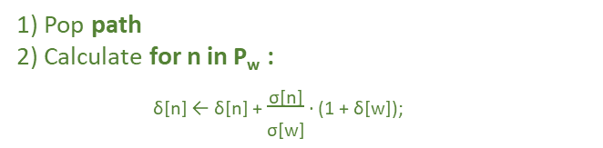
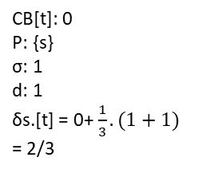
Algo demonstration (Iteration: 1, Source: s, σ[s] = 1, d[s]=0)
STACK path: v|u|t|s
QUEUE Q:
CURR pop: w
CURR n in P[w]: t
CB[t]: 0
P: {s}
σ: 1
d: 1
δs.[t] = 0+ $\frac{1}{3}.(1+1)$ = 2/3
1) Pop path
2) Calculate for n in P_{w} :
_{δ[n] ← δ[n] +} $\frac{\text{σ}\text{[}\text{n}\text{]}}{\text{σ}\text{[}\text{w}\text{]}}$ _{· (1 + δ[w]);}
t
CB[s]: 0
P:
σ: 1
d: 0
δs.[s]: 0
CB [u] : 0
P: {s}
σ: 1
d: 1
δs.[u]: 0
CB [w] : 0
P: {t, u, v}
σ: 3
d: 2
δs.[w] = 1
CB [x] : 0
P: {w}
σ: 3
d: 3
δs.[x]: 0
s
u
w
x
CB [v] : 0
P: {s}
σ: 1
d: 1
δs.[v]: 0
v

Slide 33
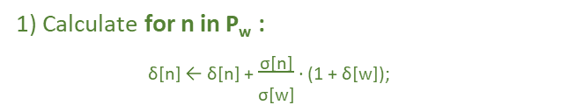

Algo demonstration (Iteration: 1, Source: s, σ[s] = 1, d[s]=0)
STACK path: v|u|t|s
QUEUE Q:
CURR pop: w
CURR n in P[w]: u
CB[t]: 0
P: {s}
σ: 1
d: 1
δs.[t] = 2/3
1) Calculate for n in P_{w} :
_{δ[n] ← δ[n] +} $\frac{\text{σ}\text{[}\text{n}\text{]}}{\text{σ}\text{[}\text{w}\text{]}}$ _{· (1 + δ[w]);}
t
CB[s]: 0
P:
σ: 1
d: 0
δs.[s]: 0
CB [u] : 0
P: {s}
σ: 1
d: 1
δs.[u] = 0+ $\frac{1}{3}.(1+1)$ = 2/3
CB [w] : 0
P: {t, u, v}
σ: 3
d: 2
δs.[w] = 1
CB [x] : 0
P: {w}
σ: 3
d: 3
δs.[x]: 0
s
u
w
x
CB [v] : 0
P: {s}
σ: 1
d: 1
δs.[v]: 0
v

Slide 34

Algo demonstration (Iteration: 1, Source: s, σ[s] = 1, d[s]=0)
STACK path: v|u|t|s
QUEUE Q:
CURR pop: w
CURR n in P[w]: v
CB[t]: 0
P: {s}
σ: 1
d: 1
δs.[t] = 2/3
1) Calculate for n in P_{w} :
_{δ[n] ← δ[n] +} $\frac{\text{σ}\text{[}\text{n}\text{]}}{\text{σ}\text{[}\text{w}\text{]}}$ _{· (1 + δ[w]);}
t
CB[s]: 0
P:
σ: 1
d: 0
δs.[s]: 0
CB [u] : 0
P: {s}
σ: 1
d: 1
δs.[u] = 2/3
CB [w] : 0
P: {t, u, v}
σ: 3
d: 2
δs.[w] = 1
CB [x] : 0
P: {w}
σ: 3
d: 3
δs.[x]: 0
s
u
w
x
CB [v] : 0
P: {s}
σ: 1
d: 1
δs.[v] = 0+ $\frac{1}{3}.(1+1)$ = 2/3
v

Slide 35
Algo demonstration (Iteration: 1, Source: s, σ[s] = 1, d[s]=0)
STACK path: v|u|t|s
QUEUE Q:
CURR pop: w
CURR n in P[w]: v
CB[t]: 0
P: {s}
σ: 1
d: 1
δs.[t] = 2/3
1) Calculate CB [w] ← CB [w] + δ[w]
t
CB[s]: 0
P:
σ: 1
d: 0
δs.[s]: 0
CB [u] : 0
P: {s}
σ: 1
d: 1
δs.[u] = 2/3
CB [w] : 0 + 1 = 1
P: {t, u, v}
σ: 3
d: 2
δs.[w] = 1
CB [x] : 0
P: {w}
σ: 3
d: 3
δs.[x]: 0
s
u
w
x
CB [v] : 0
P: {s}
σ: 1
d: 1
δs.[v] = 2/3
v

Slide 36
Algo demonstration (Iteration: 1, Source: s, σ[s] = 1, d[s]=0)
STACK path: u|t|s
QUEUE Q:
CURR pop: v
CURR n in P[v]: s
CB[t]: 0
P: {s}
σ: 1
d: 1
δs.[t] = 2/3
1) Pop path
2) Since CURR n in P[v] is s, no need of calculating δs.[s].
t
CB[s]: 0
P:
σ: 1
d: 0
δs.[s]: 0
CB [u] : 0
P: {s}
σ: 1
d: 1
δs.[u] = 2/3
CB [w] : 1
P: {t, u, v}
σ: 3
d: 2
δs.[w] = 1
CB [x] : 0
P: {w}
σ: 3
d: 3
δs.[x]: 0
s
u
w
x
CB [v] : 0
P: {s}
σ: 1
d: 1
δs.[v] = 2/3
v

Slide 37
Algo demonstration (Iteration: 1, Source: s, σ[s] = 1, d[s]=0)
STACK path: u|t|s
QUEUE Q:
CURR pop: v
CURR n in P[v]:
CB[t]: 0
P: {s}
σ: 1
d: 1
δs.[t] = 2/3
1) Calculate CB [v] ← CB [v] + δ[v]
t
CB[s]: 0
P:
σ: 1
d: 0
δs.[s]: 0
CB [u] : 0
P: {s}
σ: 1
d: 1
δs.[u] = 2/3
CB [w] : 1
P: {t, u, v}
σ: 3
d: 2
δs.[w] = 1
CB [x] : 0
P: {w}
σ: 3
d: 3
δs.[x]: 0
s
u
w
x
CB [v] : 0 + 2/3 = 2/3
P: {s}
σ: 1
d: 1
δs.[v] = 2/3
v

Slide 38
Algo demonstration (Iteration: 1, Source: s, σ[s] = 1, d[s]=0)
STACK path: t|s
QUEUE Q:
CURR pop: u
CURR n in P[y]: s
CB[t]: 0
P: {s}
σ: 1
d: 1
δs.[t] = 2/3
1) Pop path
2) Since CURR n in P[u] is s, no need of calculating δs.[s].
t
CB[s]: 0
P:
σ: 1
d: 0
δs.[s]: 0
CB [u] : 0
P: {s}
σ: 1
d: 1
δs.[u] = 2/3
CB [w] : 1
P: {t, u, v}
σ: 3
d: 2
δs.[w] = 1
CB [x] : 0
P: {w}
σ: 3
d: 3
δs.[x]: 0
s
u
w
x
CB [v] : 2/3
P: {s}
σ: 1
d: 1
δs.[v] = 2/3
v

Slide 39
Algo demonstration (Iteration: 1, Source: s, σ[s] = 1, d[s]=0)
STACK path: t|s
QUEUE Q:
CURR pop: u
CURR n in P[u]:
CB[t]: 0
P: {s}
σ: 1
d: 1
δs.[t] = 2/3
1) Calculate CB [u] ← CB [u] + δ[u]
t
CB[s]: 0
P:
σ: 1
d: 0
δs.[s]: 0
CB [u] : 0 + 2/3 = 2/3
P: {s}
σ: 1
d: 1
δs.[u] = 2/3
CB [w] : 1
P: {t, u, v}
σ: 3
d: 2
δs.[w] = 1
CB [x] : 0
P: {w}
σ: 3
d: 3
δs.[x]: 0
s
u
w
x
CB [v] : 2/3
P: {s}
σ: 1
d: 1
δs.[v] = 2/3
v

Slide 40
Algo demonstration (Iteration: 1, Source: s, σ[s] = 1, d[s]=0)
STACK path: s
QUEUE Q:
CURR pop: t
CURR n in P[t]: s
CB[t]: 0
P: {s}
σ: 1
d: 1
δs.[t] = 2/3
1) Pop path
2) Since CURR n in P[t] is s, no need of calculating δs.[s].
t
CB[s]: 0
P:
σ: 1
d: 0
δs.[s]: 0
CB [u] : 2/3
P: {s}
σ: 1
d: 1
δs.[u] = 2/3
CB [w] : 1
P: {t, u, v}
σ: 3
d: 2
δs.[w] = 1
CB [x] : 0
P: {w}
σ: 3
d: 3
δs.[x]: 0
s
u
w
x
CB [v] : 2/3
P: {s}
σ: 1
d: 1
δs.[v] = 2/3
v

Slide 41
Algo demonstration (Iteration: 1, Source: s, σ[s] = 1, d[s]=0)
STACK path: s
QUEUE Q:
CURR pop: t
CURR n in P[t]:
CB[t]: 0 + 2/3 = 2/3
P: {s}
σ: 1
d: 1
δs.[t] = 2/3
1) Calculate CB [t] ← CB [t] + δ[t]
t
CB[s]: 0
P:
σ: 1
d: 0
δs.[s]: 0
CB [u] : 2/3
P: {s}
σ: 1
d: 1
δs.[u] = 2/3
CB [w] : 1
P: {t, u, v}
σ: 3
d: 2
δs.[w] = 1
CB [x] : 0
P: {w}
σ: 3
d: 3
δs.[x]: 0
s
u
w
x
CB [v] : 2/3
P: {s}
σ: 1
d: 1
δs.[v] = 2/3
v

Slide 42
Algo demonstration (Iteration: 1, Source: s, σ[s] = 1, d[s]=0)
STACK path:
QUEUE Q:
CURR pop: s
CURR n in P[w]:
CB[t]: 2/3
P: {s}
σ: 1
d: 1
δs.[t] = 2/3
1) Pop path
2) Since CURR n in P[s] is empty, no need of calculating δs.[s].
3) CURR pop equals source node, no need of calculating CB[s].
t
CB[s]: 0
P:
σ: 1
d: 0
δs.[s]: 0
CB [u] : 2/3
P: {s}
σ: 1
d: 1
δs.[u] = 2/3
CB [w] : 1
P: {t, u, v}
σ: 3
d: 2
δs.[w] = 1
CB [x] : 0
P: {w}
σ: 3
d: 3
δs.[x]: 0
s
u
w
x
CB [v] : 2/3
P: {s}
σ: 1
d: 1
δs.[v] = 2/3
v

Slide 43
Algo demonstration (Iteration: 1, Source: s, σ[s] = 1, d[s]=0)
STACK path:
QUEUE Q:
CURR pop:
CURR n in P[w]:
CB[t]: 2/3
P: {s}
σ: 1
d: 1
δs.[t] = 2/3
1) CB of all node with respective to single vertex “s” is completed
2) Repeat the steps for all single vertices {t, u, v, w, x} next to complete the CB w.r.t all vertices .
t
CB[s]: 0
P:
σ: 1
d: 0
δs.[s]: 0
CB [u] : 2/3
P: {s}
σ: 1
d: 1
δs.[u] = 2/3
CB [w] : 1
P: {t, u, v}
σ: 3
d: 2
δs.[w] = 1
CB [x] : 0
P: {w}
σ: 3
d: 3
δs.[x]: 0
s
u
w
x
CB [v] : 2/3
P: {s}
σ: 1
d: 1
δs.[v] = 2/3
v

Slide 44
Complexity
Betweenness centrality can be computed in O(nm + n² log n) time and O(n + m) [stack + queue + predecessors] space for weighted graphs. For unweighted graphs, running time reduces to O(nm).
For undirected graph we need to divide the computed betweenness-centrality by two, since every path is added twice.

Slide 45
Page rank
PageRank (PR) is an algorithm used by Google Search to rank web pages in their search engine results.
PageRank is a way of measuring the importance of website pages.
PageRank works by counting the number and quality of links to a page to determine a rough estimate of how important the website is.

Slide 46
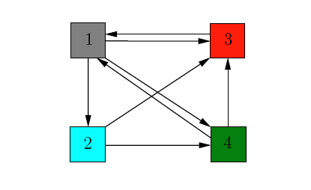
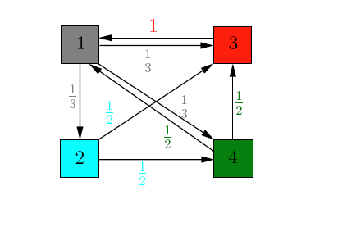
Page rank
Assume each node as single webpage with outgoing edge refers link to other webpage and incoming edge as link pointing to it from other pages
Adding weights to each edge of a node with value $\frac{1}{\#outgoing edges}$

Slide 47
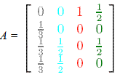
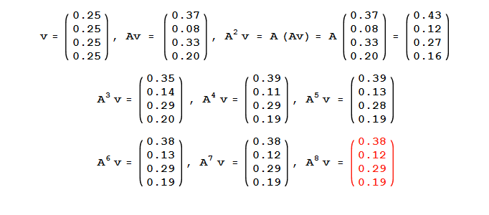
Page rank
1) Each row of Matrix A represents a vertex and its backlinks from other vertices.

Slide 48
Page rank
Required:
We need to solve the linear equation:
Ax = x (Ax = ʎx)
So, we need to find Eigen vector for ʎ = 1.

Slide 49
End of slide

